Slide 1
Program The Real World
The Change is here

Slide 2
A MicroController &connector
BreadBoard/connecting wires
Devices and sensors
A Computer
An IDE
What All We Need

Slide 3
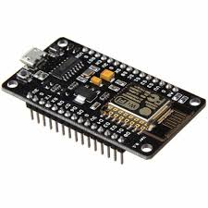
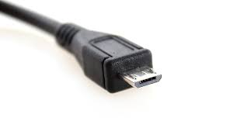
MicroController/Processor
& connector
MicroController/Processor
Arduino UNO,nano,..
NodeMCU
ESP8266
Raspberry-Pi 3,zero…
Etc…..
Chapter
1
connector
MicroUSB
USB-B

Slide 4
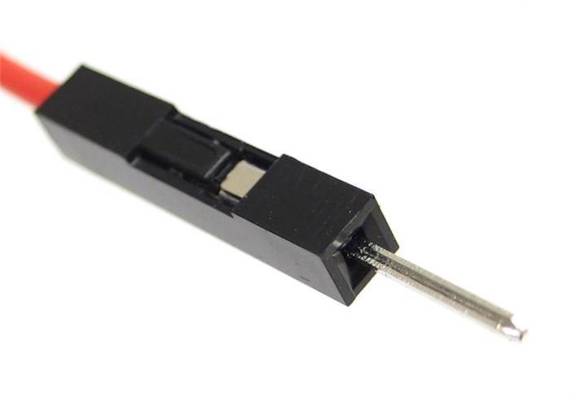
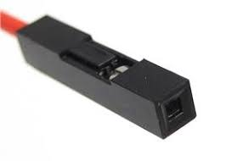
BreadBoard & Connecting Wires
Chapter
2
Male to Male
Male to Female
Female to Female

Slide 5
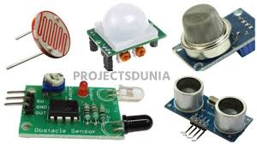
Devices & Sensors
Devices
LCD display
LED & Display
BUZZER
POT
RGB led
Etc…
Sensors
Sound Sensor
Light Sensor
UltraSonic
InfraRED
Temperature
Etc…
Chapter
3

Slide 6

Computer
It Can be a laptop ,desktop, macbook, notebook etc..
With a windows or mac os installed (default for nodemcu)
Chapter
4

Slide 7
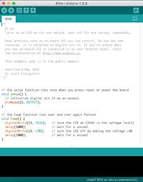
IDE
For Node MCU we need Arduino IDE
Chapter
5

Slide 8
Digital & Analog
Digital | Analog
Digital value is either 0 or 1 | Analog value can range from 0 to 1024
Digital Functions are 1.digitalRead 2.digitalWrite | Analog Functions are 1.analoglRead 2.analogWrite
Digital values are often associated with devices like switch,buzzer,led etc.. | Analog values are associated with sensors and potentiometer etc..

Slide 9
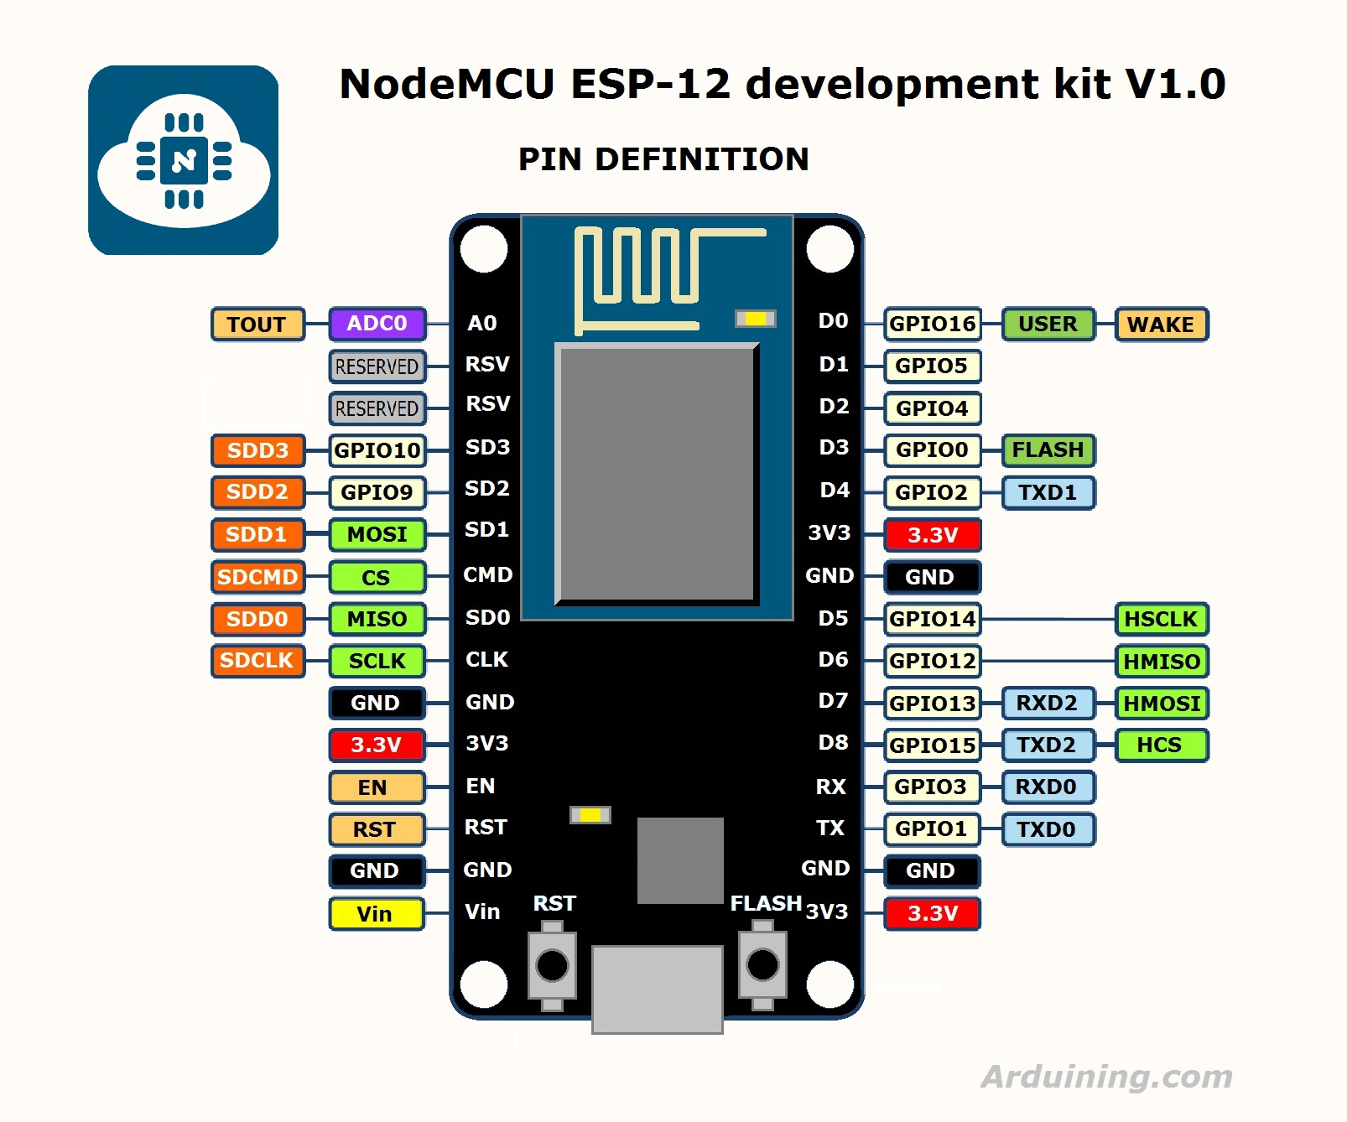

Slide 10
GPIO | Node Dpin | State | Restrictions
0 | D3 | 3.3V | No Hi-Z,not used
1 | TX | - | Not usable during Serial transmission rx/tx
2 | D4 | - | -
3 | RX | - | Not usable during Serial transmission rx/tx
4 | D2 | - | -
5 | D1 | - | -
6 - 11 | Flash connection | x | Not usable, and not broken out
12 | D6 | - | -
13 | D7 | - | -
14 | D5 | - | -
15 | D8 | 0V | Pull-up resistor not usable
16 | D0 | - | No pull-up resistor, but pull-down instead Should be connected to RST to wake up

Slide 11
IDE Configuration
Install Arduino software
Install driver
Install ESP8266 Library
Select nodeMCU board version 1.0
Connect to nodeMCU using microUSB
Select port number
Type the script, compile, and run
Open Serial monitor if needed

Slide 12
All the initialization should be done inside setup and get executed once
void
setup
pinMode(12,OUTPUT);
pinMode(16,INPUT);
Serial.begin(9600);

Slide 13
All the initialization should be done inside setup and get executed once
void
loop
Serial.println(“hi");
delay(1);
digitalWrite(12,HIGH);
digitalRead(12);
analogWrite(12,120);
anaolgRead(A0);

Slide 14
NETWORKING-1
Steps
#include<ESP8266WiFi.h> #include<String.h>
//declare server globally WiFiServer server(portno); //portno=80
//Under setup create active point WiFi.mode(WIFI_AP);
Create ssid,password for hotspot WiFi.softAP(“ssid",“password");
Print ip address and start server Serial.println( WiFi.softAPIP() ); server.begin();

Slide 15
NETWORKING-2
Steps
//create a client WiFiClient client;
//Check the client is connected [ if connected print clients ip and connected message ] client= server.available(); when it returns 0 Serial.println("connected"); Serial.println( client.remoteIP() );
Check until the response from client is available while(client.connected()==1 && client.available()==0) { delay(1); }

Slide 16
NETWORKING-2
Steps
When available read the request/response and store to a variable String request=buji.readStringUntil('\r') ; delay(1);
check the request and perform action if(request.indexOf("ledon") !=-1 ) { statements }

